Slide 1


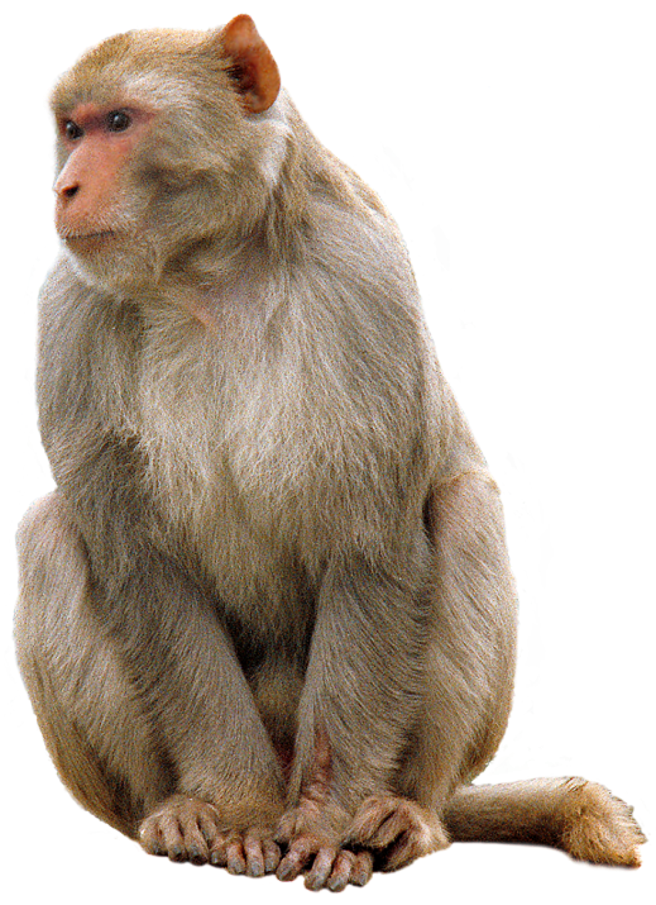
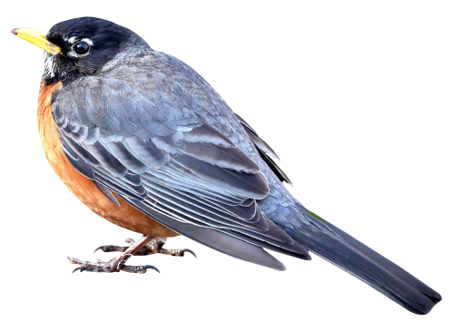
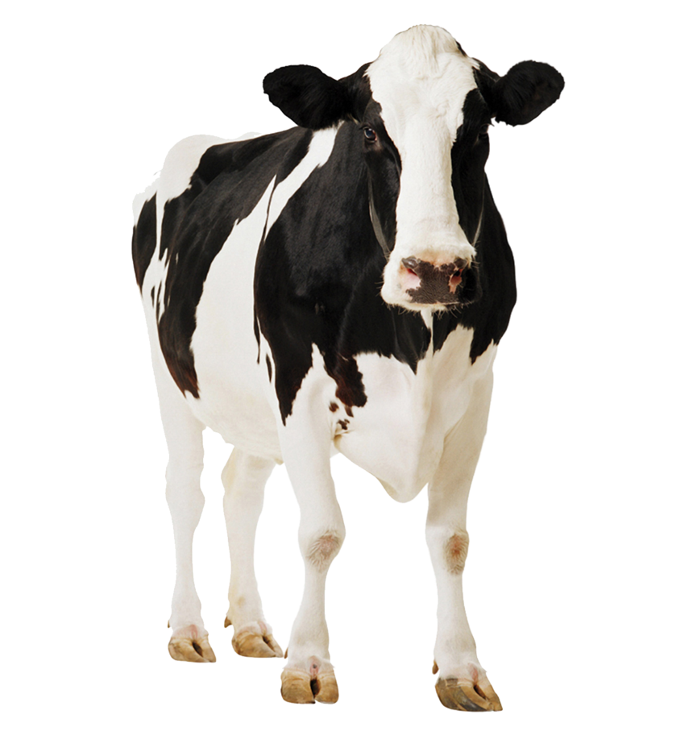
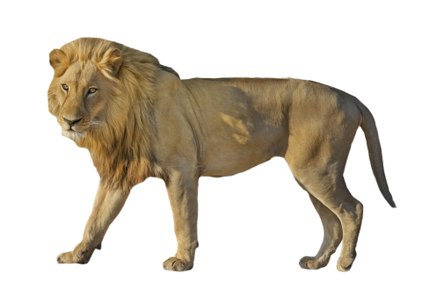
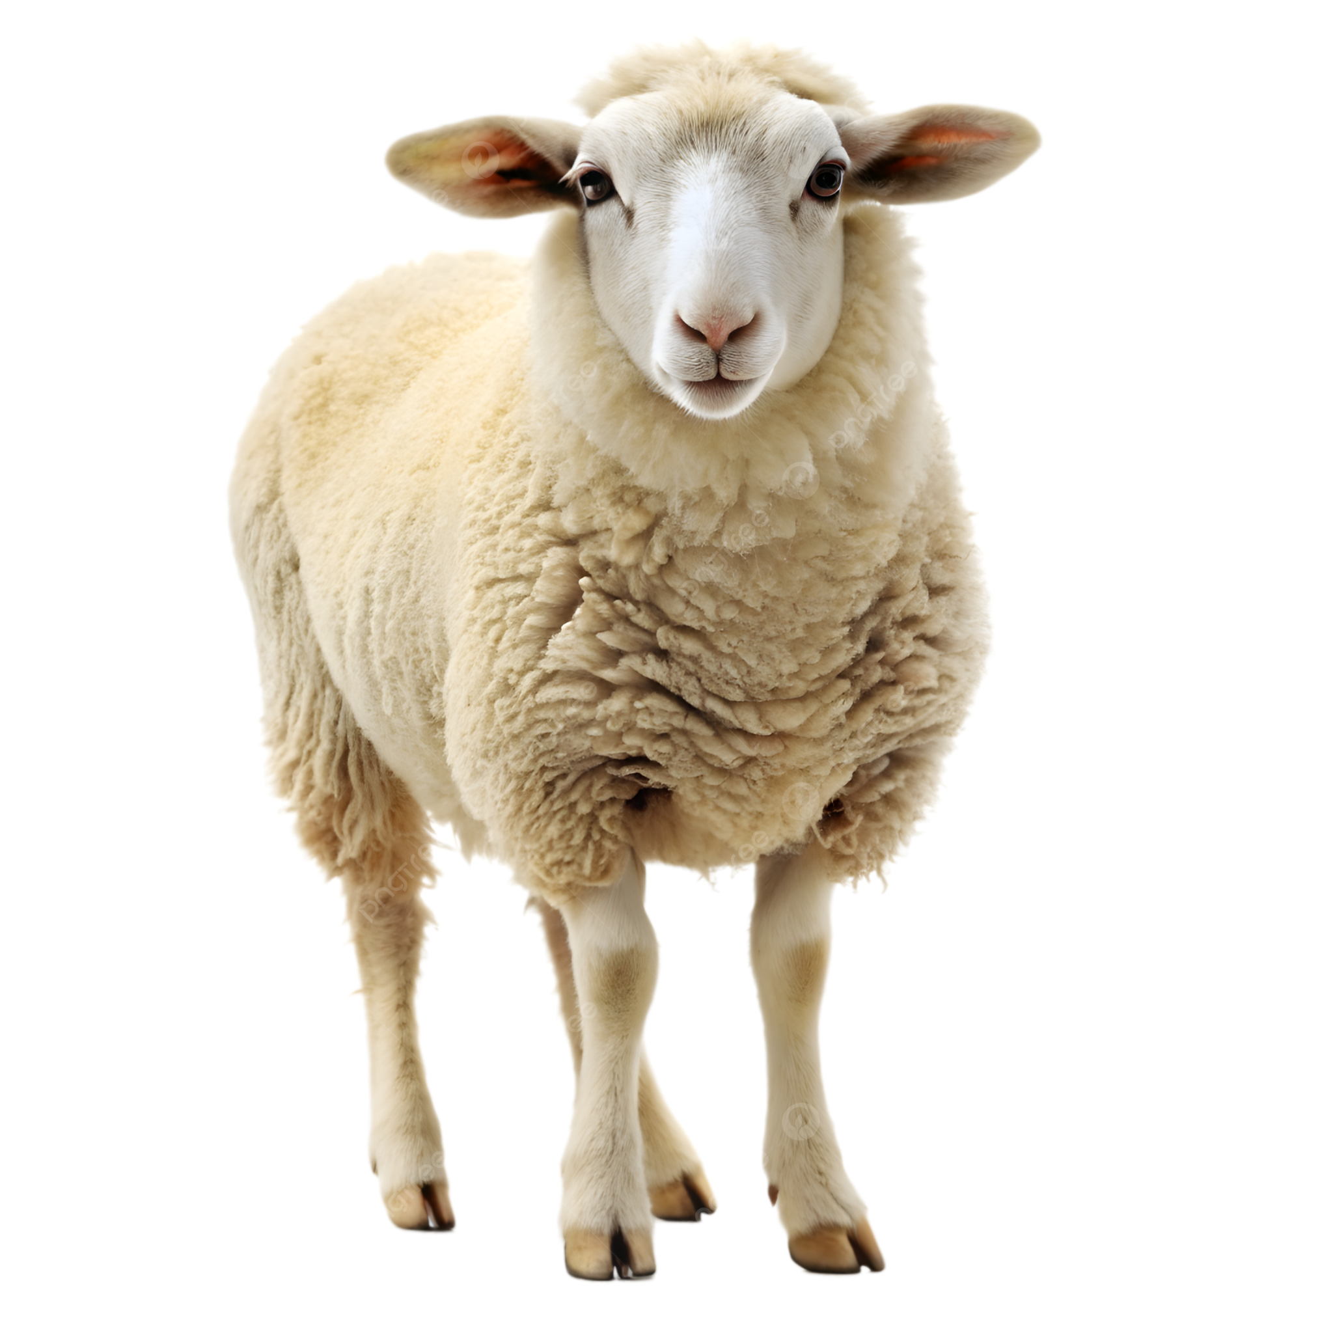

Are You Seeing What I’m Hearing?
Sammy Gagou, Joseph Ross, Nadine Hughes, Julia Guzzo, Aneesh Sallaram

Slide 2

Introduction and Motivation
AI and Machine Learning can help assist scientists and conservation organizations by being trained on audio that has been collected and assisting with future research and efforts.
Assist where manpower can be expensive and difficult to reproduce on a large-scale.
Goal: Identify species based on their audio Spectrograms
Dataset: 875 audio samples
Classes: 10 species
Dataset divided into training (80%), validation (10%), and test (10%) sets
Model Architecture: Convolutional Neural Network CNN

Slide 3

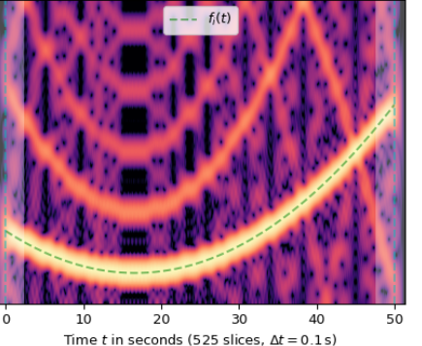
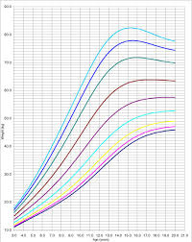
Experimental Design
Audio representations:
 | WAVEFORM
 | SPECTROGRAM
 | PERCENTILES (Martin et al 2021)*
1DConv
FFN
Label
2DConv
FFN
Label
2DConv
FFN
Label
Researchers in bioacoustics are starting to use percentiles / empirical probability density to identify soundscapes since the data is more compressed.
Notes:
Data normalization: We first had to normalize all of the audio files so that they had the same peak audio level and sampling rate. Sampling rate refers to the number of audio samples recorded per second. In other words, it’s how many snapshots are taken of a continuous (analog) sound wave. The higher the sampling rate, the more accurately the original sound is represented because this means more snapshots are taken.
Normalizing the volume avoids the model underfitting the classification pattern based solely on volume.
Normalizing the sampling rate ensures the spectrograms have the same upper frequency bound, so the images being processed have the same dimensions.
After these steps, all 875 audio files have roughly the same fundamental acoustic properties, eliminating ask lot of room for error be controlling for extraneous variables.

Slide 4
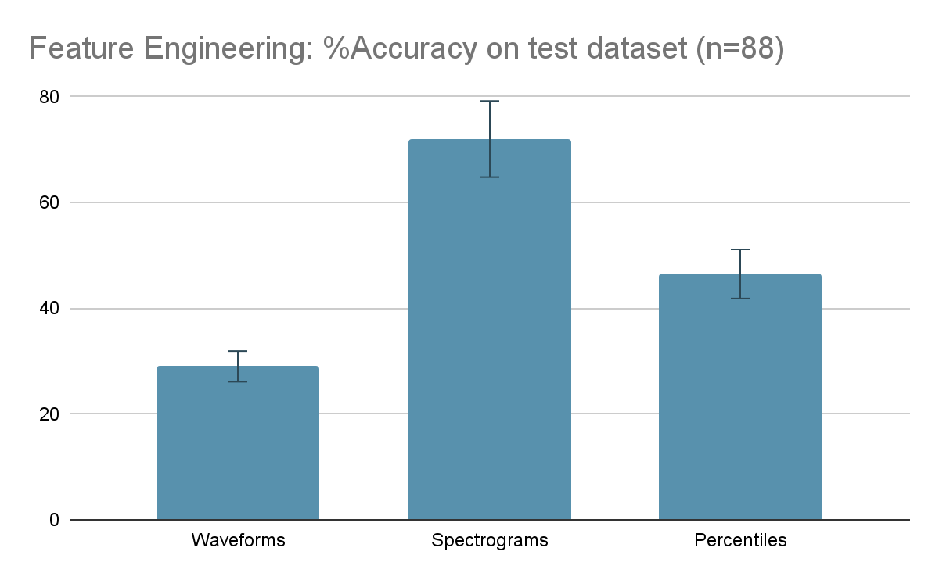
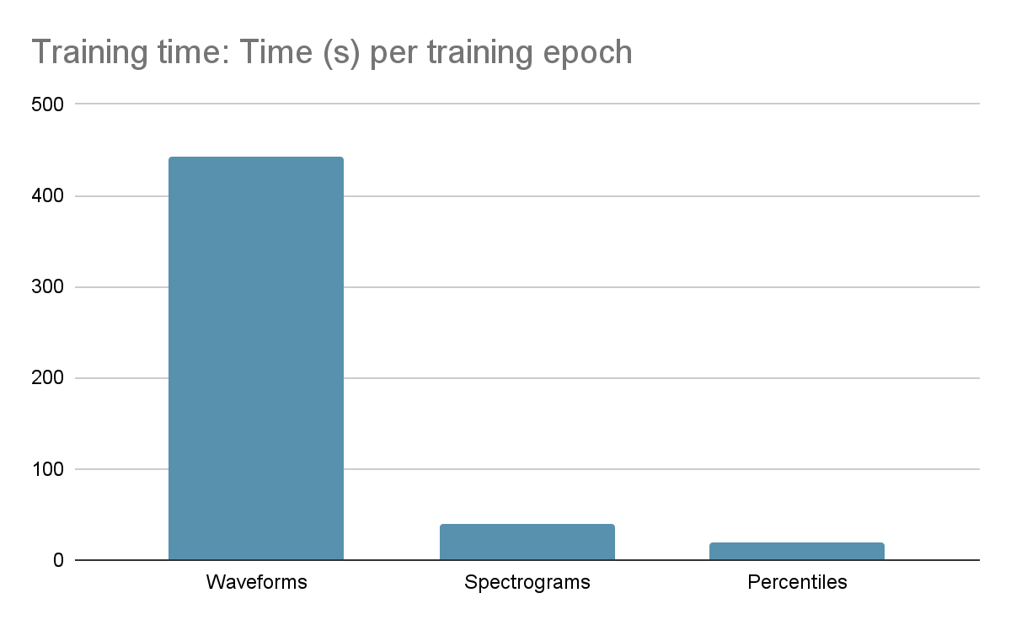
Results
Processing raw waveforms takes more time and energy, and is less accurate. Feature Engineering is required for good results.
Percentiles are less accurate than spectrograms, but process significantly faster
Results are promising for more compressed data since it represents the contours of the spectrogram

